Slide 1



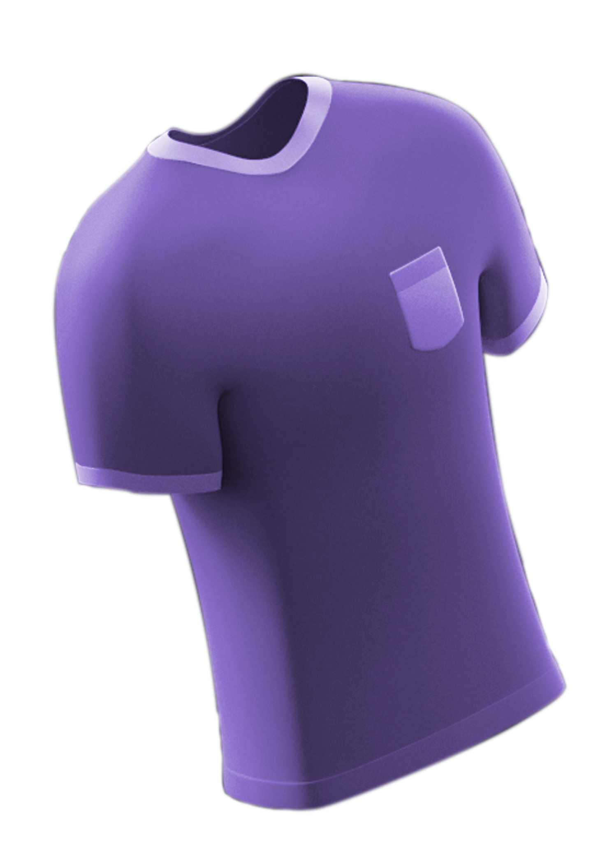
Fabrics.
Revolutionizing men’s fashion

Slide 2

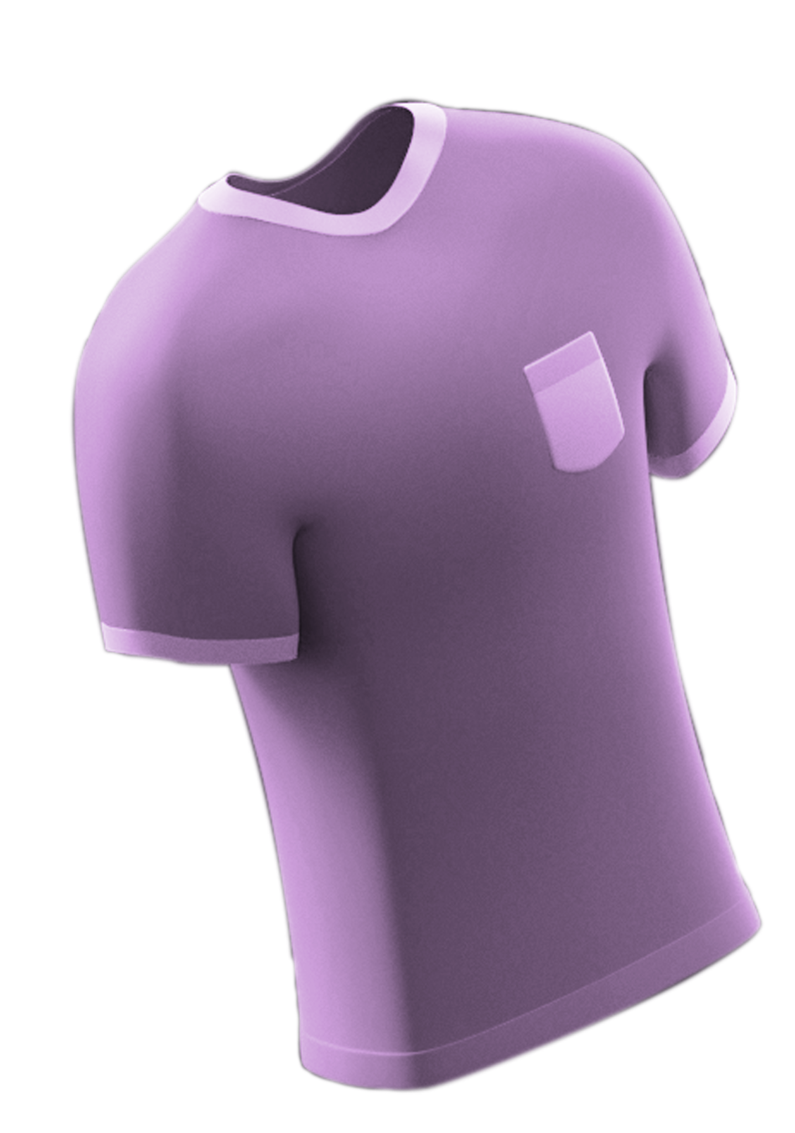

The Problem
The existing men’s fashion landscape is very boring and mediocre. The styling and desings of the products are being same from ages. Also there is no cultural touch to the designs.

Slide 3

Solution
Fabrics brings to you the most stylish products specially curated for men. We blend the modern men’s with our cultural touch to produce beautiful and stylish designs. Each piece of clothing you hold is the legacy of out great nation’s rich textile, craft and culture

Slide 4
Hardware Requirements
Software Requirements
CPU: Dual-core or higher, with clock speed depending on traffic and complexity.
RAM: 4GB minimum, more recommended for higher traffic or complex applications.
Storage: Minimum 50GB for a basic website, more for complex ones and media-rich content.
Internet connection: Reliable and with sufficient bandwidth to handle traffic volume.
Operating system: Linux (e.g., Ubuntu, CentOS) is popular for its stability and security. Windows Server can also be used.
Web server software: Apache, Nginx, or LiteSpeed are common choices.
Database software: MySQL, PostgreSQL, or MongoDB are popular options depending on website functionality.
Programming languages: HTML, CSS, and JavaScript are essential. Additional languages like Python, PHP, or Ruby may be needed for complex features.

Slide 5

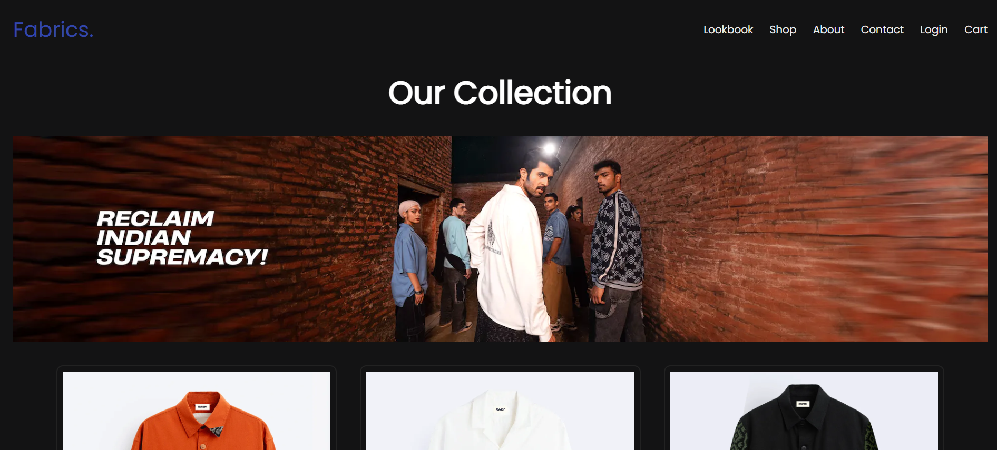
Screenshots

Slide 6


Screenshots

Slide 7
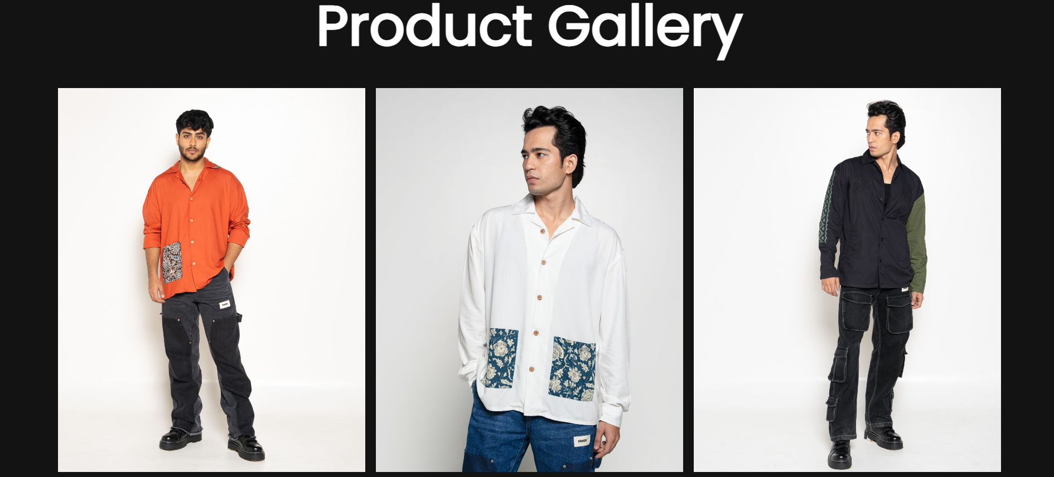
Screenshots

Slide 8
Thank You.
Anything unclear or burning questions you need answered?

